Slide 1
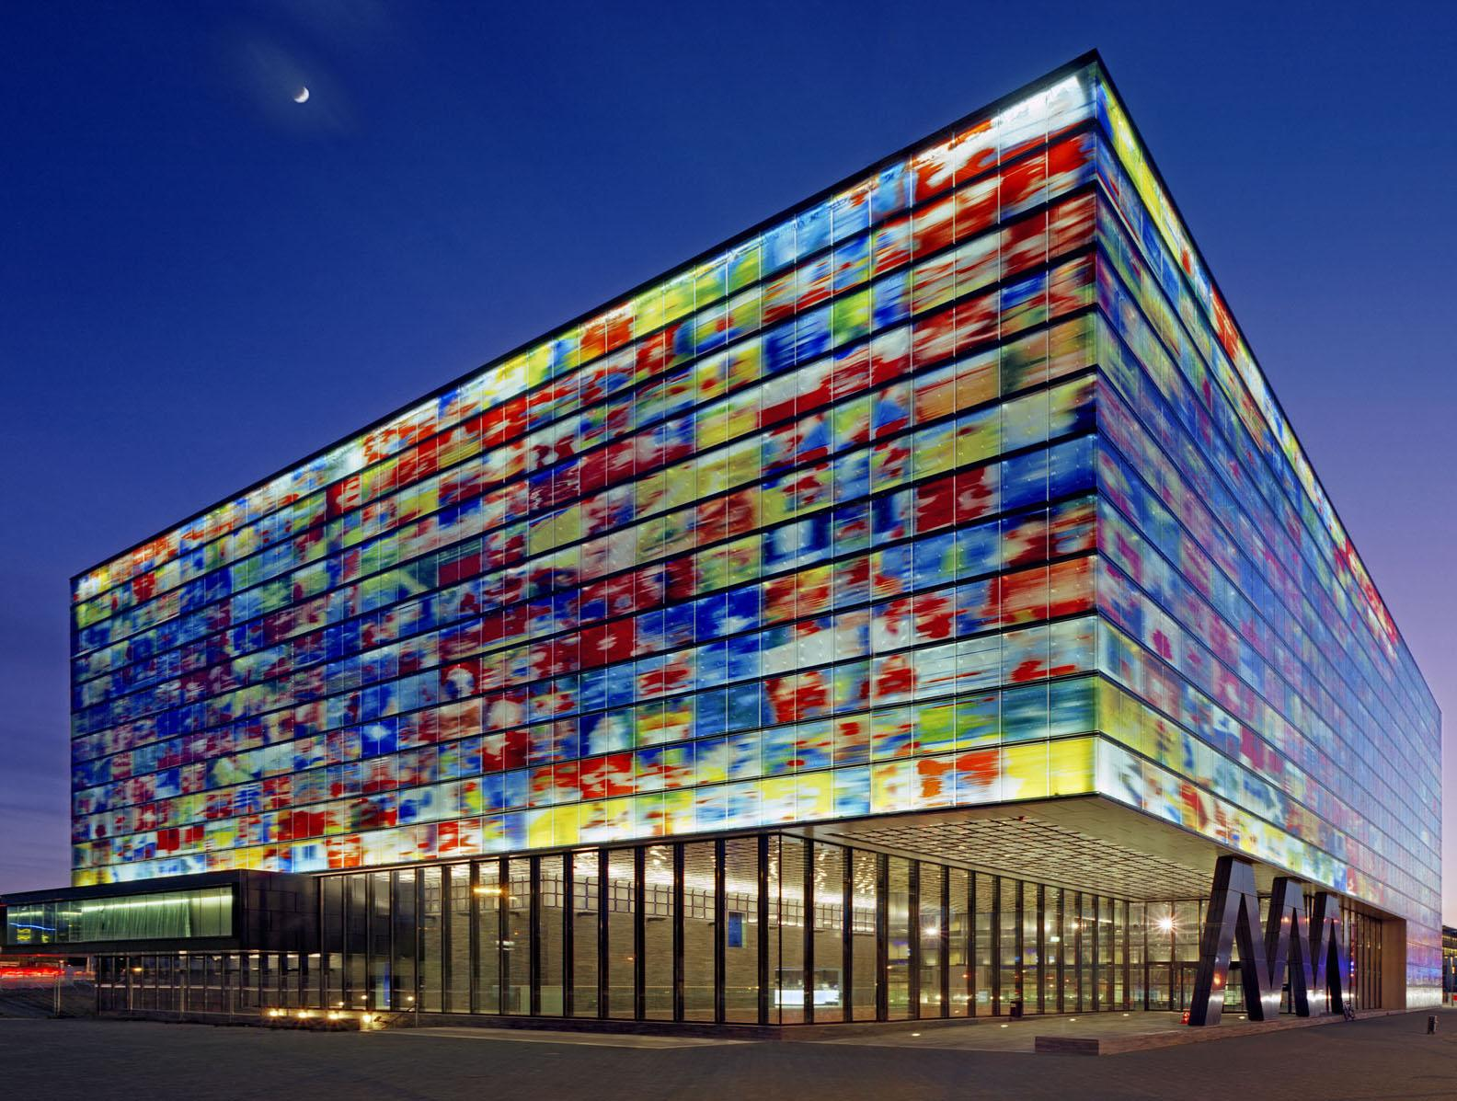

BECOMING A TDR
AMIA 2016
Tom De Smet

Slide 2
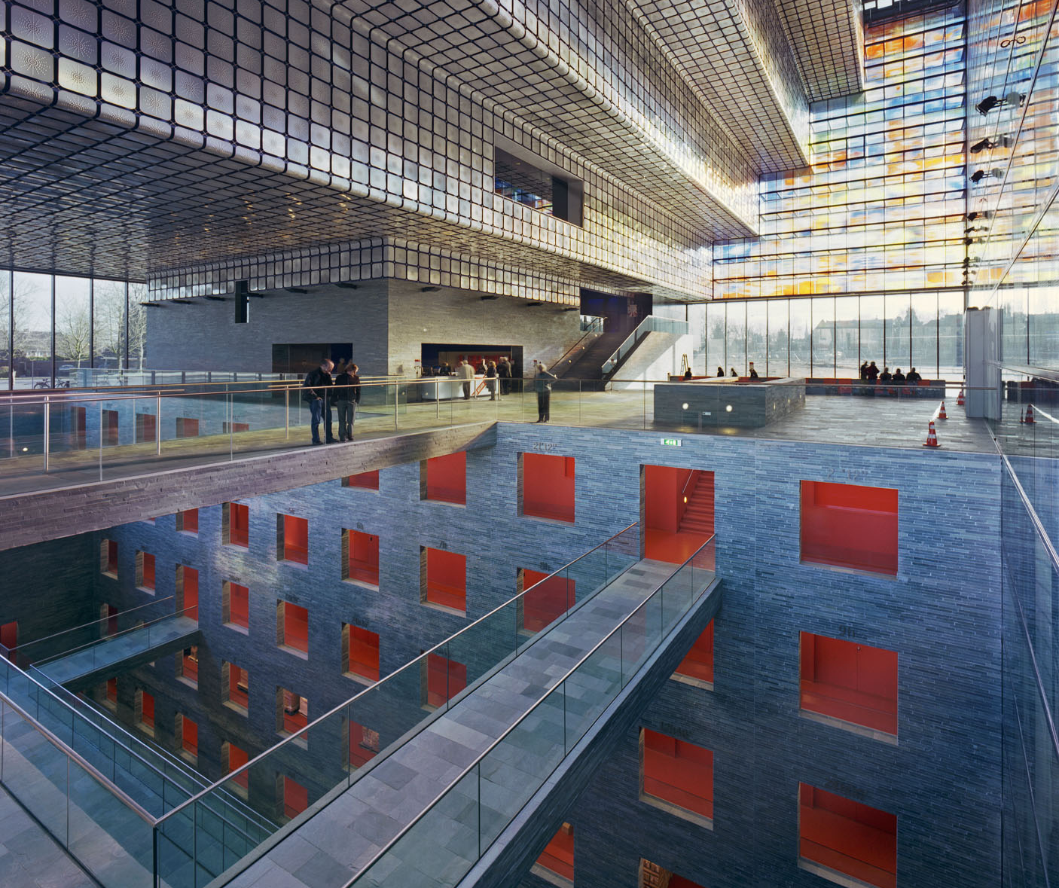

ONZE
MISSIE

Slide 3
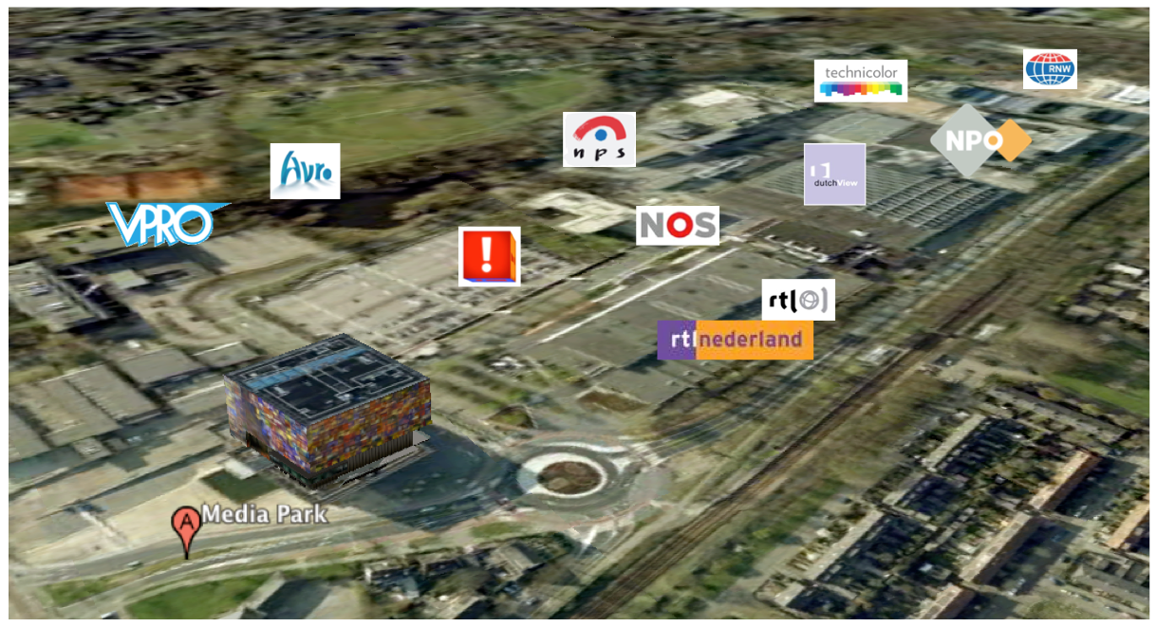
Notes:
Output demands by broadcast professionals, but also creative industry professionals, fellow heritage institutions and museums as well as educational publishers, schools and academics.

Slide 4

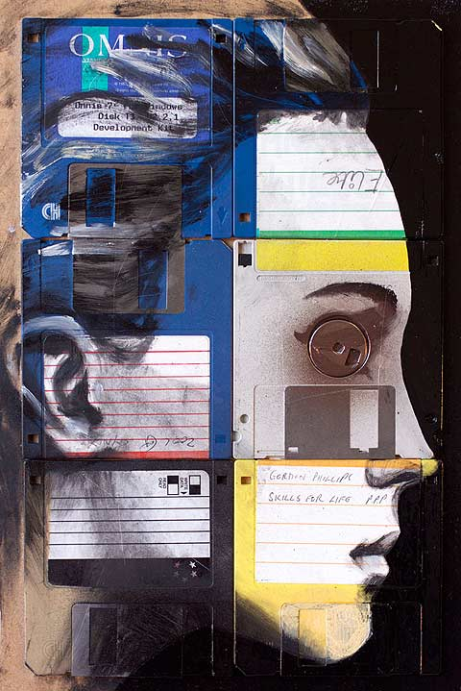
PRESERVING AV COLLECTIONS…
Technological shifts
Changing storage media
Evolving playout equipment
Obsolescence
Nick Gentry, Obsolescence III (2011)

Slide 5
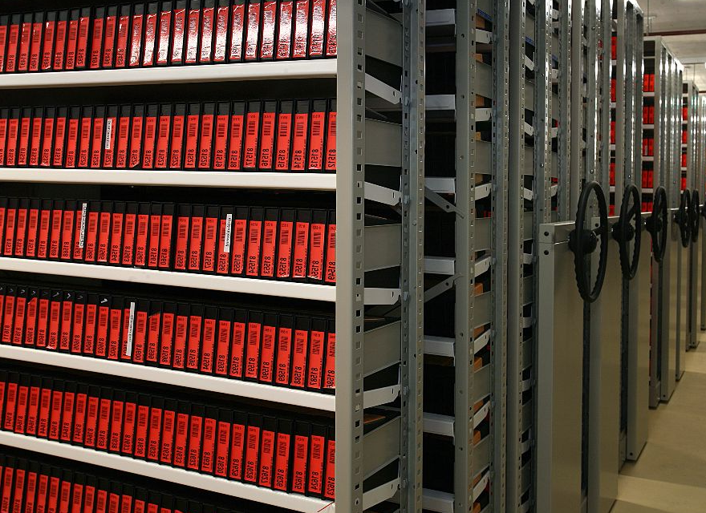
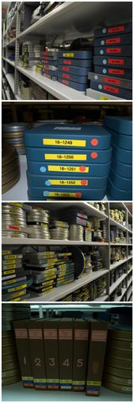
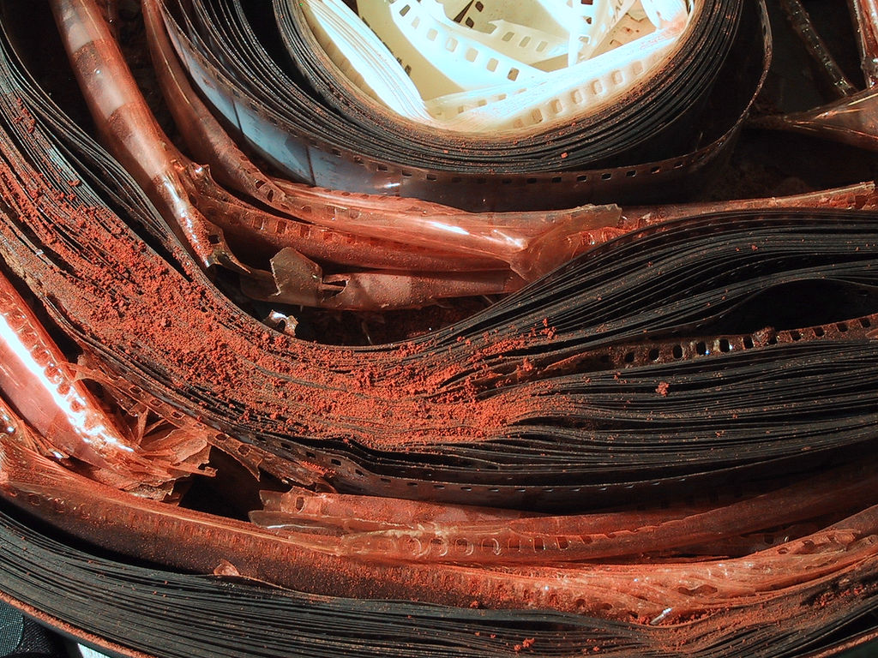
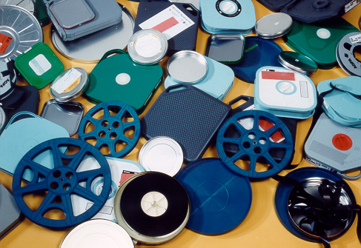
SO, WHAT’S NEW?
Notes:
So what’s new, one could argue?
After all, AV-archives have been dealing with formatprogression, with obsolescence , with migration and conversion from the beginning of their existence.
This ofcourse is caused by the nature of their collections. AV archives need technical equipment to be able to see and hear their content and because this equipment is regularly renewed, the AV formats had to be converted and migrated too.
Nothing new therefore.

Slide 6
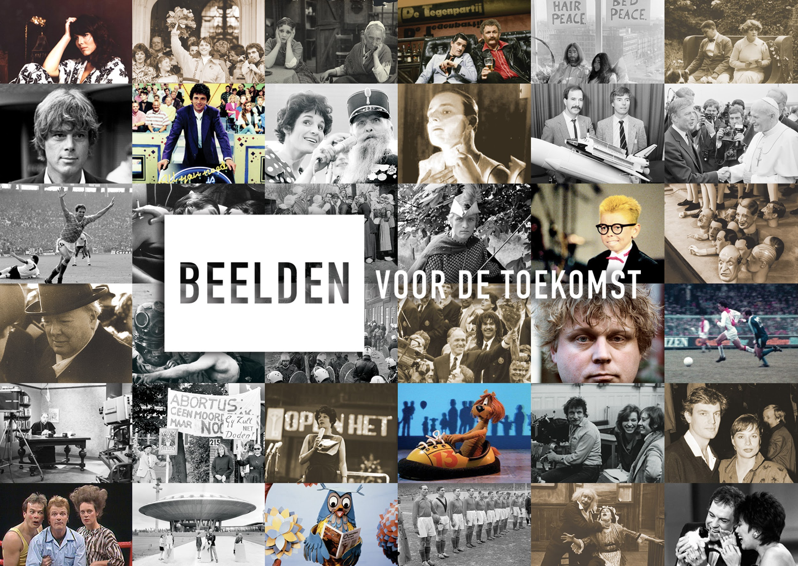

Slide 7
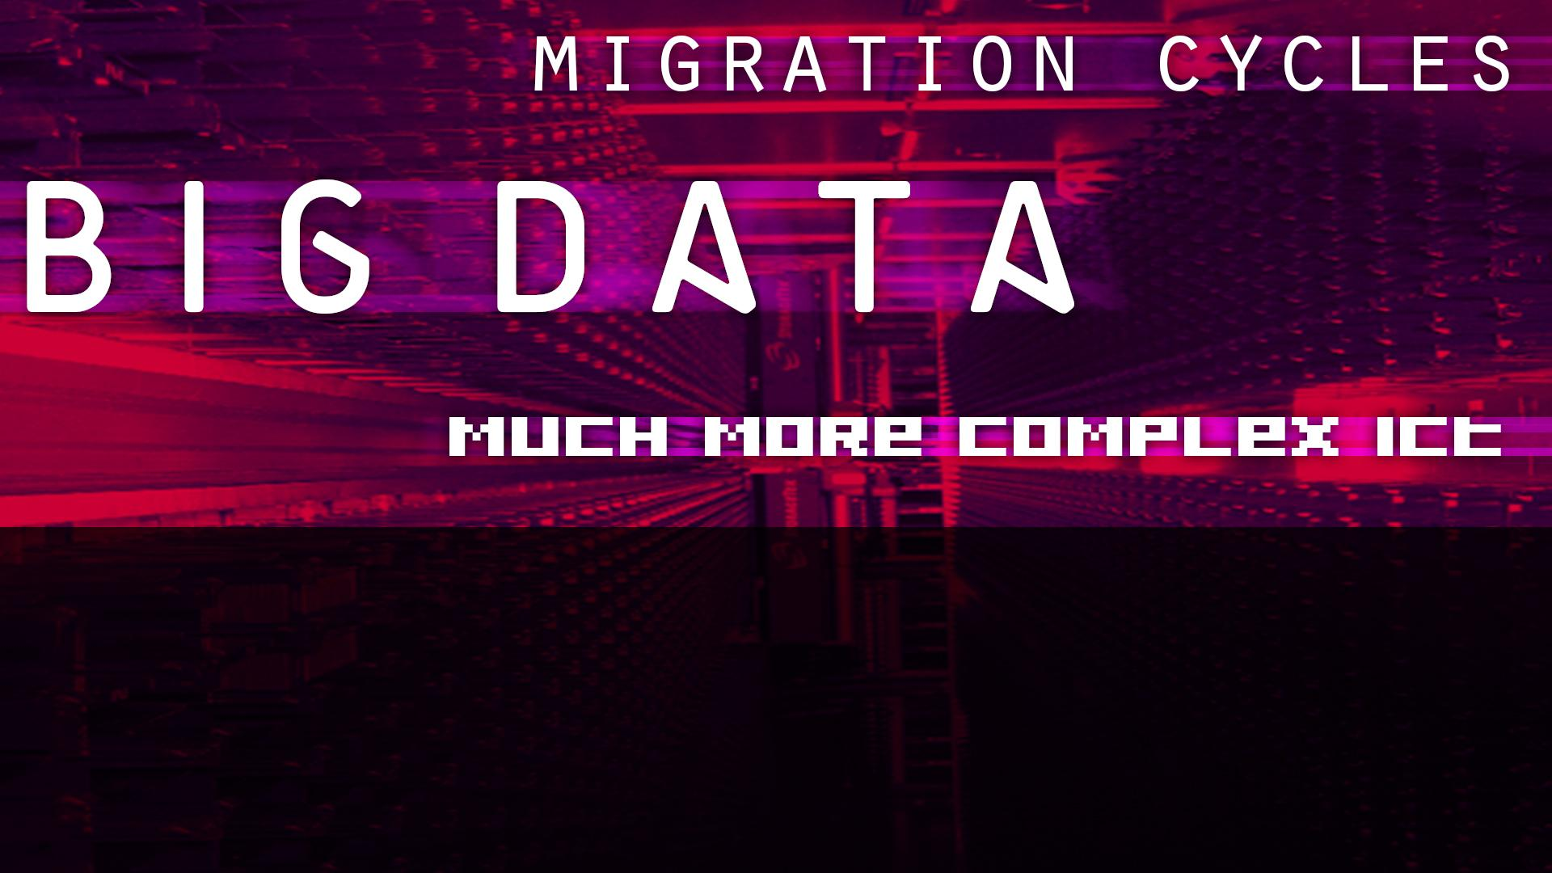
Require rethinking the archive’s organization
Remodelling of archival processes
Standards, competences, relations with users/donors
Creating a trusted digital environment

Slide 8
SO, WHAT’S NEW?
Notes:
So what’s new, one could argue?
After all, AV-archives have been dealing with formatprogression, with obsolescence , with migration and conversion from the beginning of their existence.
This ofcourse is caused by the nature of their collections. AV archives need technical equipment to be able to see and hear their content and because this equipment is regularly renewed, the AV formats had to be converted and migrated too.
Nothing new therefore.

Slide 9
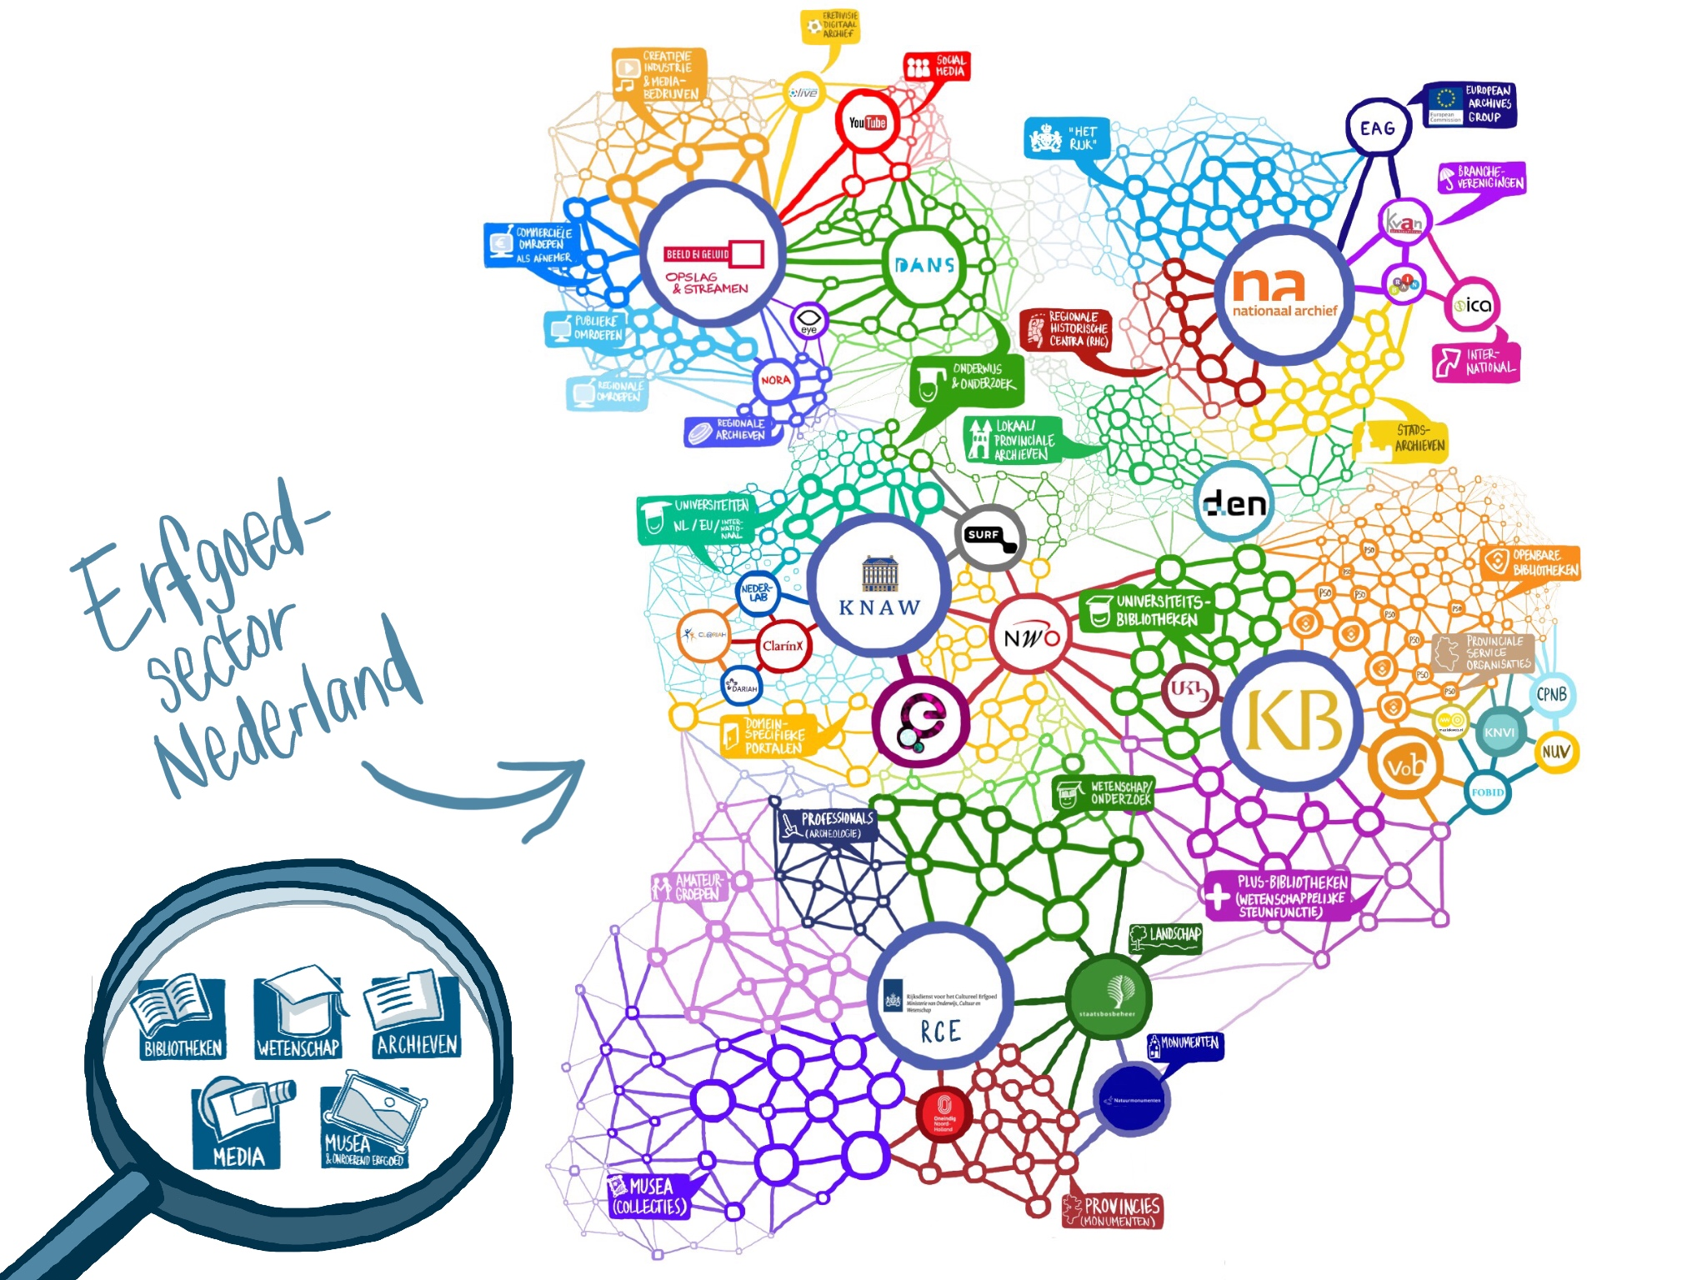
Notes:
In het netwerk van publieke instellingen en particulieren die zorg dragen voor behoud, beheer en gebruik van digitaal erfgoed, onderscheiden we vijf domeinen

Slide 10

ANOTHER ‘NEW’ CONCEPT: TRUST
Keeper of cultural heritage
Keeper of commercial assets
Preservation as a (paid) service
Legal obligations
Funding
Becoming formally trustworthy
Certification

Slide 11
TRUST IN THE CONTEXT OF DIGITAL PRESERVATION
Data level
Organisational level

Slide 12
TRUST IN THE CONTEXT OF DIGITAL PRESERVATION
Data level
Do I get out what I put in?
Can I use it?
Accessibility
How can I be sure that it hasn’t
been tampered with?
Integrity
Authenticity
Notes:
Trust in the context of digital preservation circles around three basic questions.

Slide 13
TRUST IN THE CONTEXT OF DIGITAL PRESERVATION
Organisational level
Governance & organizational viability
(mission statement, preservation strategic plan, collection policy)
Organisational structure & staffing (skilled professionals, clear roles and responsabillities)
Procedural accountability & preservation policy framework (documenting all processes, decision making & goalsetting, selfassesment, compliance with standards)
Notes:
Trust in the context of digital preservation circles around three basic questions.

Slide 14
TRUST IN THE CONTEXT OF DIGITAL PRESERVATION
Organisational level
Financial sustainability (short & longterm business planning)
Contracts, licenses & liabilties (clear & legal contracts with depositors)

Slide 15
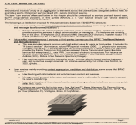
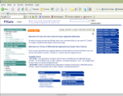
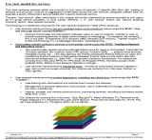
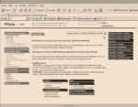
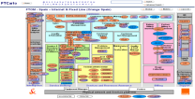
STEPS TO TRUSTWORTHINESS
AS IS ANALYSIS
BUSINESS CONCEPT
IMPLEMENTATION
Analysis of existing functions, processes and standards
OAIS compliant definitions
Embedding a new MAM system in existing processes
OAIS compliant preservation workflows
Mapping to standards, gapanalysis
Adaptation and implementation
Notes:
The most important tool to help is the OAIS model.
The Open Archive Information System.
Designed by NASA mostly, as a way to safeguard various digital data that was produced during missions into space, data that ofcourse could never be lost or become inaccessible.

Slide 16

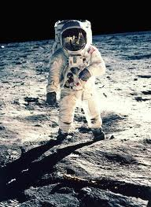
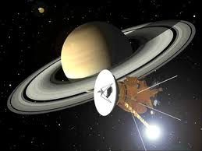
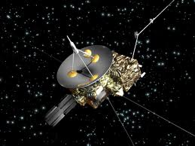
O A I S
Open Archive Information system
Reference model for digital archives
Designed in 1982 ( NASA (US), ESA (EU), RSA (USSR), NASDA (Japan)
ISO Standard 14721 since 2002

Slide 17

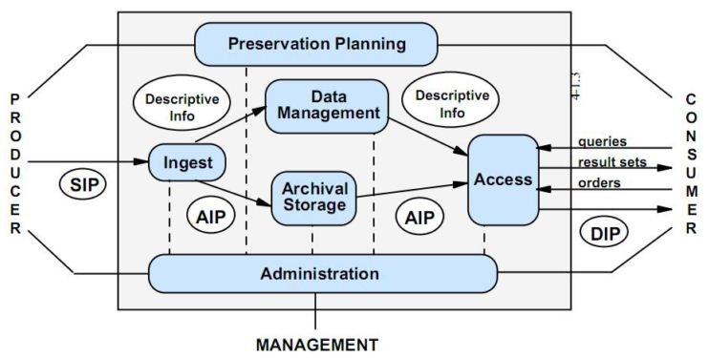
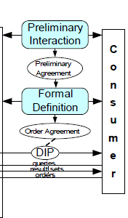
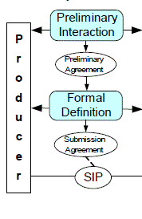
Frames of reference STANDARDS, MODELS, CERTIFICATES
OAIS, PREMIS, PAIS, TDR-DATA SEAL OF APPROVAL (DSA), PRESTO PRIME, DRAMBORA, SPOT, EBU P-meta, PBCore, VideoMD and AudioMD, NARA reVTMD. ANSI/NISO Z39.87 .. .. ..
Notes:
Not just OAIS, a lot of other standards had assisted us to

Slide 18
Frames of reference PRODUCERS AND CONSUMERS
Designated Communities: Typologies and Demands V1.0
Designated Communities: Monitoring Mechanisms V1.0
Guidelines for Submission and Order Agreements V1.0
Standard Service Level Agreement V1.0

Slide 19
Frames of reference PROCESSES AND DATA
Information model Digital Archive v1.0
Preservation Metadata Dictionary v1.2
Life cycle management :workflows en events
Information Package Definitions SIP, AIP, DIP
Inventory of AV-technical and provenance metadata

Slide 20
Frames of reference STORAGE AND PRESERVATION
Preservation planning
Storage
Guidelines for Preservation Plans of Action v1.0
Technology Watch
Normative description

Slide 21
Frames of reference ICT RELATED TOPICS
1. Security Policy
2. Backup Policy
3. Disaster Recovery Planning

Slide 22
TRUST IN THE CONTEXT OF DIGITAL PRESERVATION
Data level
Organisational level

Slide 23
Producers (broadcasters) and heritage collections
COLLECTIONS
Acquisition
Selection
Registration
Cataloguing
Metadata
“content”
Ingest
Storage
Application management
Servicedesk
Digitalisation
Digitaal/analog Asset management
“technical stuff”
Museum
Services
Education
B2B
“customers and users”
3
PROJECT PORTFOLIO MGT
IT
&
INFRA
MARKETING AND SALES
R&D
Consumers
Notes:
Trust in the context of digital preservation circles around three basic questions.

Slide 24
A NEW ORGANISATIONAL MODEL

Slide 25
OAIS FUNCTIONS AT SOUND AND VISION
Ingest | ICT, Digitisation dpt., Ingest Dept.
Archival Storage | ICT + Ericsson
Data Management | (Limited coordination ) ICT, Access Dept., Metadata Mgt, afd. Ingest Dept, Development Dept.
Access | Order service iMMix, KCC, Access Dept.
Preservation Planning | (Ad hoc) ICT Mgt TechWatch and DC Monitoring: by KCC and R&D
Administration | (Limited coordination) ICT, KCC, Access Dept. (?)
Notes:
Not just OAIS, a lot of other standards had assisted us to

Slide 26
ROLES AND RESPONSIBILITIES
Producers | Broadcasters, ECV, heritage collections, Governmental Institutions, a.o.
Consumers | Media professionals, Education, General Public Internal users
Management Digital Archive | Unitmanager Archive : strategy / policy Strategic/tactical policy and coordination: Collecton Policy Advisor : Digital Collection Policy, Selection/ Retention Policy Digital Preservation Officer: Preservation Policy, Quality Watch and Certification Information manager: Information policy, Metadata & Digital Life Cycle Management Domain managers : Accountmanagement ,Preservation- and Access Services IP - specialist : Access-, Use- and Rights management data policy

Slide 27
STEPS TO TRUSTWORTHINESS
AS IS ANALYSIS
BUSINESS CONCEPT
IMPLEMENTATION
Analysis of existing functions, processes and standards
OAIS compliant definitions
Embedding a new MAM system in existing processes
OAIS compliant preservation workflows
Mapping to standards, gapanalysis
Adaptation and implementation

Slide 28
MAM AND PRESERVATION
WHAT DOES THE NEW MAM OF NISV OFFER TO PRESERVATION?
MAM-system can meet a number of ISO 16363 (TDR) requirements
All the remaining requirements need to be met through policies
and work processes
→ But a MAM can help you a great deal with structuring your workflow management

Slide 29
Start DSA
Application
Trajectory
2013 2014 2015 2016 2017
Preservation implementation
development
Delivery
OAIS compliant
policies-procedures
Start TDR
Policy Project
Acquiring
DSA
C
Coordinate
Edit Rewrite
Self Assessment
Research
preservation
standards
Preparation
DIN/ISO
RFP MAM SYSTEM
including OAIS requirements
Selection
MAM system
Policy level
Org. Level
Unit Archive
IT Level
Design Customize Test
MAM system
Reorganisation Archive UNIT
aligned with
OAIS process model

Slide 30


Levels of trustworthiness CERTIFICATION
Basic Certification is granted to repositories which obtain Data Seal of Approval certification (DSA) - 16 guidelines
Extended Certification is granted to Basic Certification repositories which in addition perform a structured, externally reviewed and publicly available self-audit based on DIN 31644 - 34 guidelines
Full Certification is granted to repositories which in addition to Basic Certification obtain full external audit and certification based on ISO 16363 - 109 guidelines
Notes:
Sageguarding and keeping files accessible is not done by digitizing the collections. In fact, once you have you digitized and stored the content, most of the work is still to begin, and what’s more important, will never end.
You have to make sure that the content is truly preserved, meaning that is is to be made permanently accessible to users.
Storing is merely preserving bytes. Preservation is about being able to permanently reproduce and use the information in those bytes, in current formats, with current technology. Preservation is constant migration.
In this way digital sustanability means nothing else than permanent access.

Slide 31

Levels of trustworthiness CERTIFICATION
Basic Certification is granted to repositories which obtain Data Seal of Approval certification (DSA) - 16 guidelines
Extended Certification is granted to Basic Certification repositories which in addition perform a structured, externally reviewed and publicly available self-audit based on DIN 31644 - 34 guidelines
Full Certification is granted to repositories which in addition to Basic Certification obtain full external audit and certification based on ISO 16363 - 109 guidelines
Notes:
Sageguarding and keeping files accessible is not done by digitizing the collections. In fact, once you have you digitized and stored the content, most of the work is still to begin, and what’s more important, will never end.
You have to make sure that the content is truly preserved, meaning that is is to be made permanently accessible to users.
Storing is merely preserving bytes. Preservation is about being able to permanently reproduce and use the information in those bytes, in current formats, with current technology. Preservation is constant migration.
In this way digital sustanability means nothing else than permanent access.

Slide 32
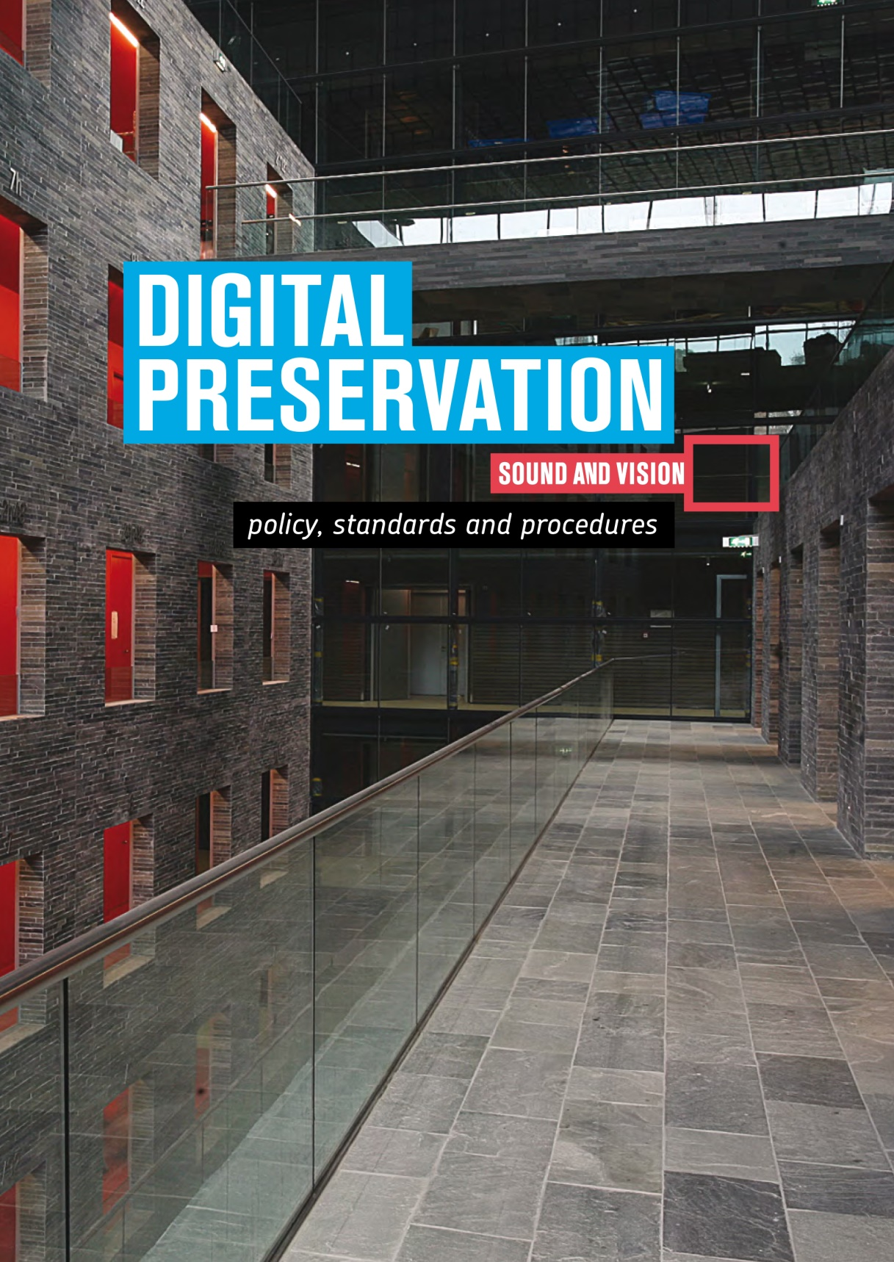
MORE?
Full application DSA:
https://assessment.datasealofapproval.org/assessment_195/seal/pdf/
Preservation policy:
http://publications.beeldengeluid.nl/pub/388
Mid 2017: paper with all details as well as links to all the documents.

